Slide 1
Web scraping Project
Scraping the Personal Experiences of
Antihypertensive Drug Side Effects
On WebMD Database
22th, April, 2019
SANGWOO, LEE

Slide 2


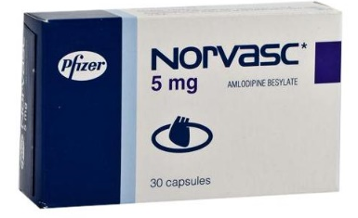

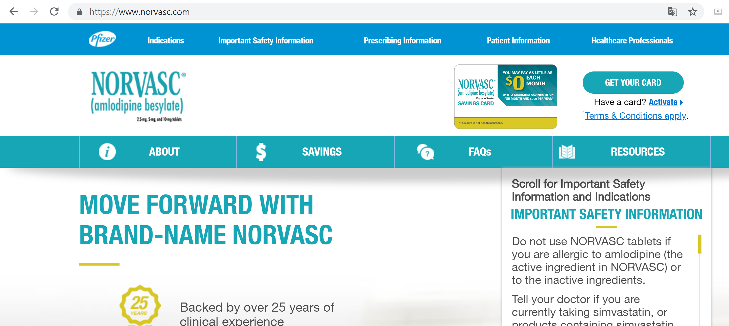
Introduction
You need to take medicine!
151/99 mmHg
√

Slide 3
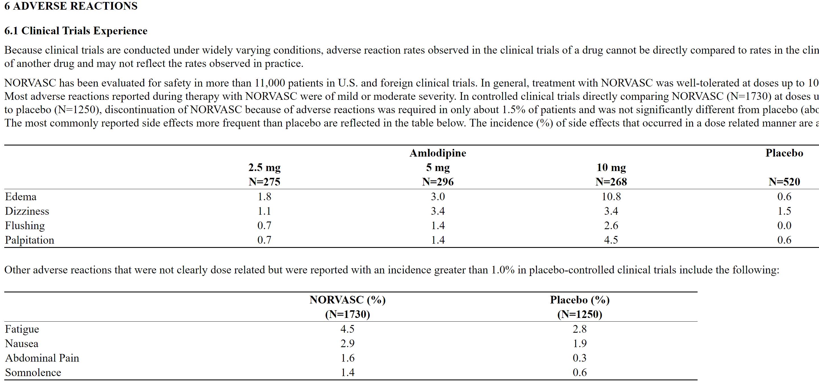
Introduction
Information at web sites of pharmaceutical companies are hard to understand.
Example:

Slide 4
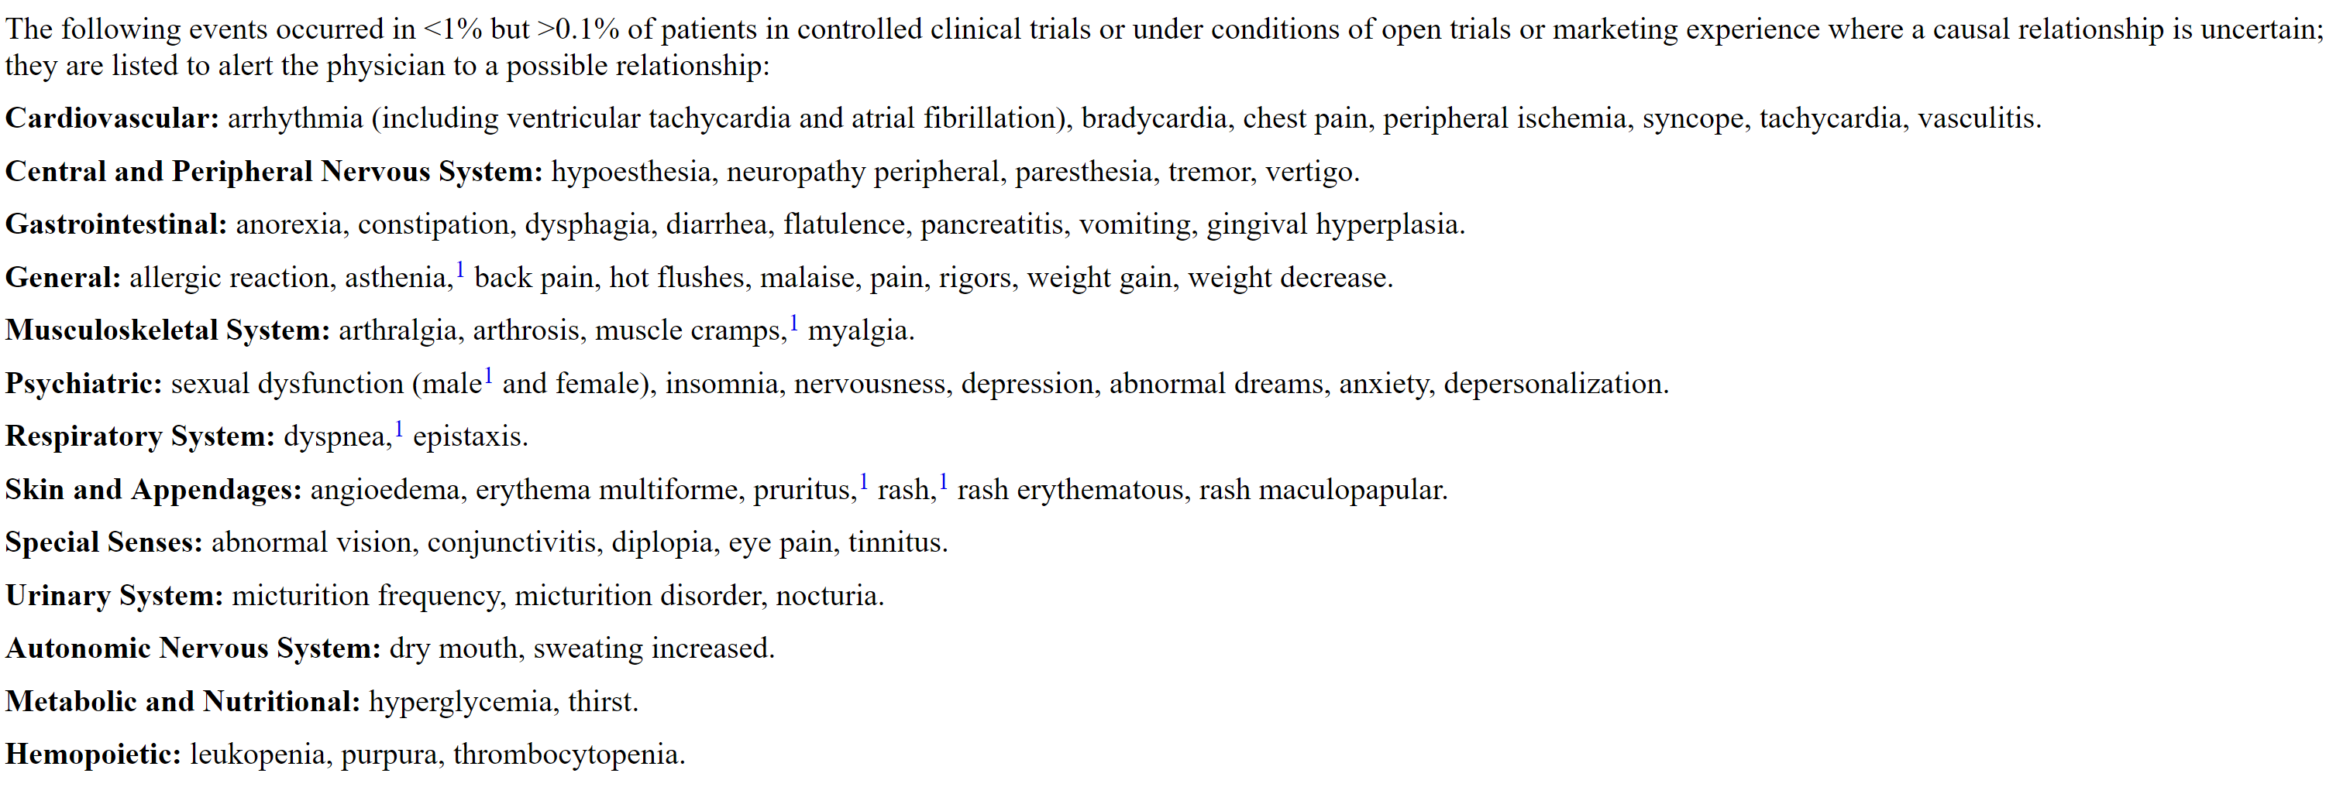
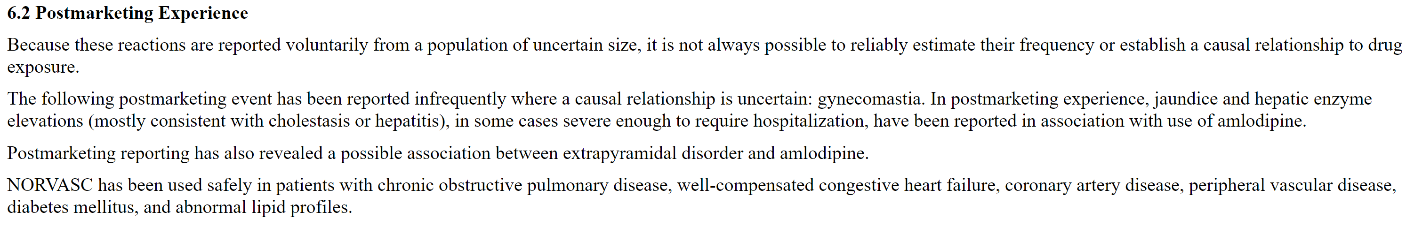
Introduction
Example:
…….Because these reactions are reported voluntarily from a population of uncertain size, it is not always possible to reliably estimate their frequency or establish a causal relationship to drug exposure…

Slide 5
Introduction
Objective
Scrape from webMD website for review opinions,
with focus on quantitative and qualitative analysis of side effects ( https://www.webmd.com )

Slide 6
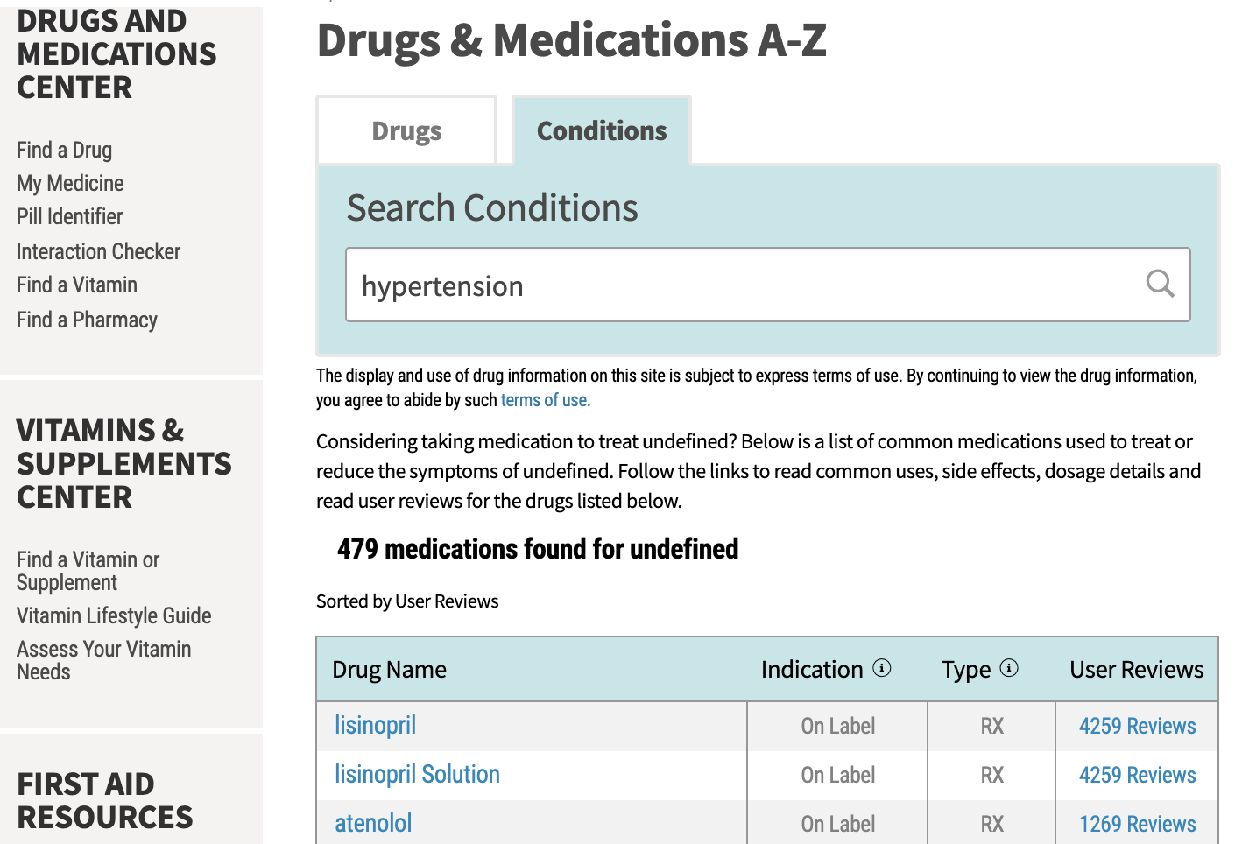
Data Extraction(1/2)
Used pkg: scrapy
Analyzed dataset definition
https://www.webmd.com
‘drugs and supplements’ ➔ ‘conditions’
enter ‘hypertension’ or ‘high blood pressure’
scraped from 9 most reviewed drugs

Slide 7
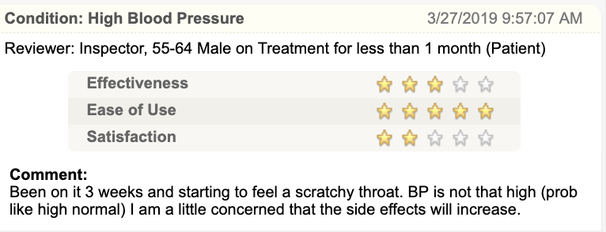
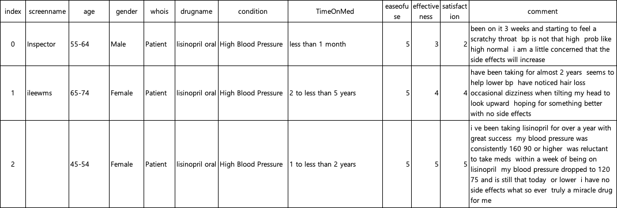
Data Extraction(2/2)
Example of review opinion
Scraped dataset example

Slide 8
Data Preprocessing on ‘comments’ (1/2)
Filtering on ‘comment’ column
Used stop words of nltk and own definition
Lemmatization on ‘comment’ column
Used nltk
A table of side effects vs. synonyms created based on ‘comment’ column
Synonyms need to be found since many reviewers use diverse expressions.
Three are many typos.
Side effects considered in this study: 28 categories
Cough, Pain, Allergy, Headache, Nausea & Vomit
Lethargy, Anxiety & depression, Dizzy, Blurring, Skin problem
Appetite, Diarrhea, Sleep disorder, GI symptom
Sweating, Hair loss, Breathe discomort
Mental alteration, Abnormal sensation
Movement disorder, Constipation, Sexual dysfunction
Thirsty, Dysurinate, Swallow difficult, Ear problem
Voice change, Pancreatitis

Slide 9
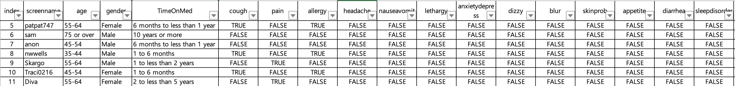
Data Preprocessing on ‘comments’ (2/2)
A scraped example with side effect columns added
6342 reviews about 9 drugs for hypertension

Slide 10
Results(1/6): ease of use vs drugs

Slide 11
Results(2/6): effectiveness vs drugs

Slide 12
Results(3/6): satisfaction vs drugs

Slide 13
Results(4/6): drug vs. avg # of side effects per reviewer

Slide 14
Results(5/6): drug vs. % of reviewers with cough

Slide 15
Results(6/6): drug vs. % of reviewers with pain

Slide 16
Discussion
Conclusion
We scraped from webMD website for review opinions and performed quantitative and qualitative analysis of side effects
Future work
The table of side effects vs. synonyms need more validations.
Datasets
Increase size of datasets
Choose other drugs

Slide 17
Appendix

Slide 18
Appendix: drug vs. % of reviewers with lethargy

Slide 19
Appendix : drug vs. % of reviewers with ear
problem

Slide 20
Appendix: drug vs. % of reviewers with ear problem

Slide 21
Appendix: age vs. avg # of side effects per reviewer

Slide 22
Appendix: gender vs. avg # of side effects per reviewer

